Slide 1
Travel FU
App that’s got your back!!
By
Abhijit Ghosh, Maxwell Wang, Manasi Sukthankar, Ted Yang,

Slide 2
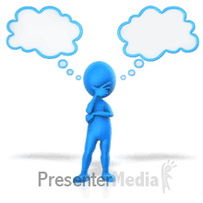
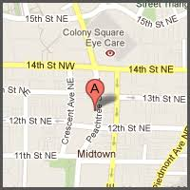
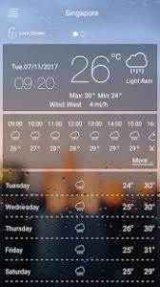


Idea Origination

Slide 3
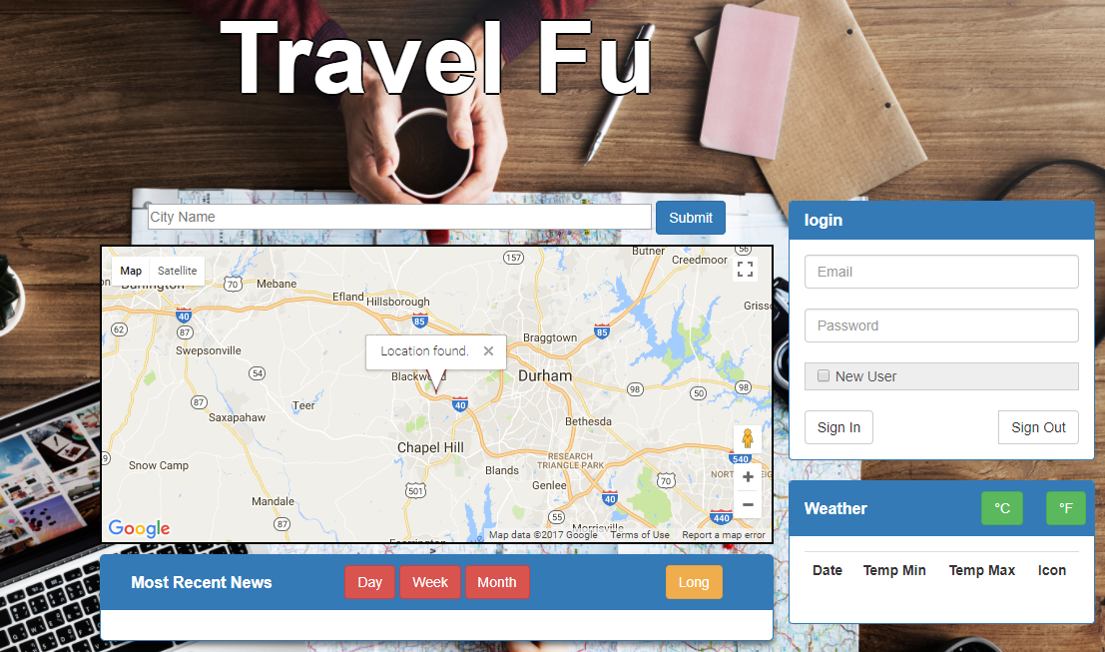

Slide 4
Future Functionalities
Receive feedback/ send message
Things to do in the area
Best mode of transport
Places to eat , drink and stay

